Slide 1


Photonic Quantum Circuits
QOI - PHYS 513
(Kevin Tanner, Rishi Sivakumar, Sahith Konakalla, Sharjeel Ahmad)
May 6, 2025

Slide 2
Table of Contents
DiVincenzo Criteria & Qubits
Discrete Variable Photonics
Continuous Variable Photonics
Photon Gates
Decoherence & Losses
Current Progress

Slide 3

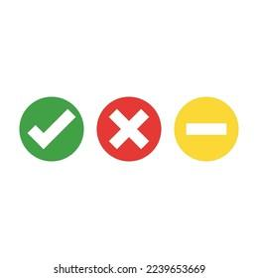
Motivation
DiVincenzo criteria for quantum computation
1. Well-defined state space of qubits
Can encode qubits using the presence or absence of a mode (like polarization)
Can also encode qubits using the number of photons
2. Ability to initialise the state of the qubits
Ideally requires deterministic single photon sources
Relies on non-deterministic process to generate multi-photon states
UNIVERSITY OF ILLINOIS URBANA-CHAMPAIGN
GRAINGER ENGINEERING

Slide 4
Motivation
DiVincenzo criteria for quantum computation
3. Long relevant decoherence times
Photons have weak interactions with environment
4. A universal set of quantum gates
Single-qubit operations simple
Options for two-qubit gates are promising but currently underdeveloped
5. A qubit-specific measurement capability
Photon detection is already a large area of research
UNIVERSITY OF ILLINOIS URBANA-CHAMPAIGN
GRAINGER ENGINEERING

Slide 5
Motivation
Other advantages of photons
Photons can exhibit quantum phenomena at room temperature
Quantum superposition, interference, and entanglement
Photons can be entangled over large distances
Quantum networks
UNIVERSITY OF ILLINOIS URBANA-CHAMPAIGN
GRAINGER ENGINEERING

Slide 6
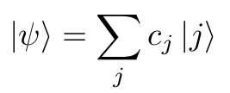
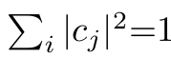
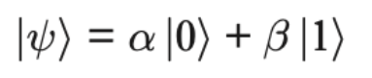
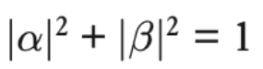
What is a Qubit?
What is a photon?!
Single particle excitation of an optical field mode
What is a qubit?
a two-level quantum system represented as:
where
What is a qudit?
a n-level quantum system represented as:
where
A photonic qubit/dit utilizes photons and their properties to represent and manipulate quantum information
UNIVERSITY OF ILLINOIS URBANA-CHAMPAIGN
GRAINGER ENGINEERING

Slide 7
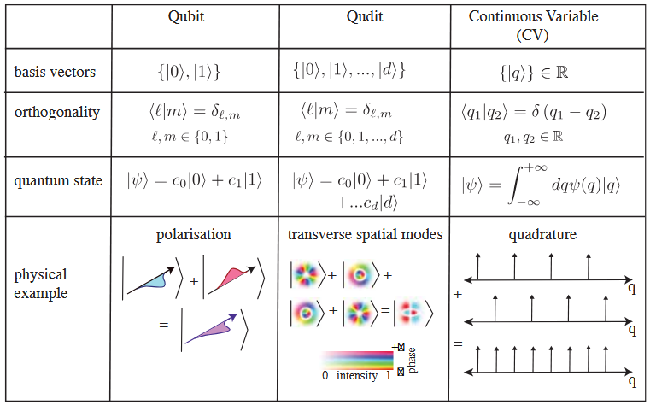
Continuous vs Discrete Variable
Continuous Variable
Information encoded in the properties of the EM field that have continuous distributions
Ex: position and momentum
Discrete Variable
Information encoded in modal properties of photons that have specific values from a finite set
Ex: Polarization
Romero, et al., arXiv:2404.03367 (2024).
UNIVERSITY OF ILLINOIS URBANA-CHAMPAIGN
GRAINGER ENGINEERING

Slide 8
Discrete Variable
Mainly being developed by PsiQuantum
UNIVERSITY OF ILLINOIS URBANA-CHAMPAIGN
GRAINGER ENGINEERING

Slide 9
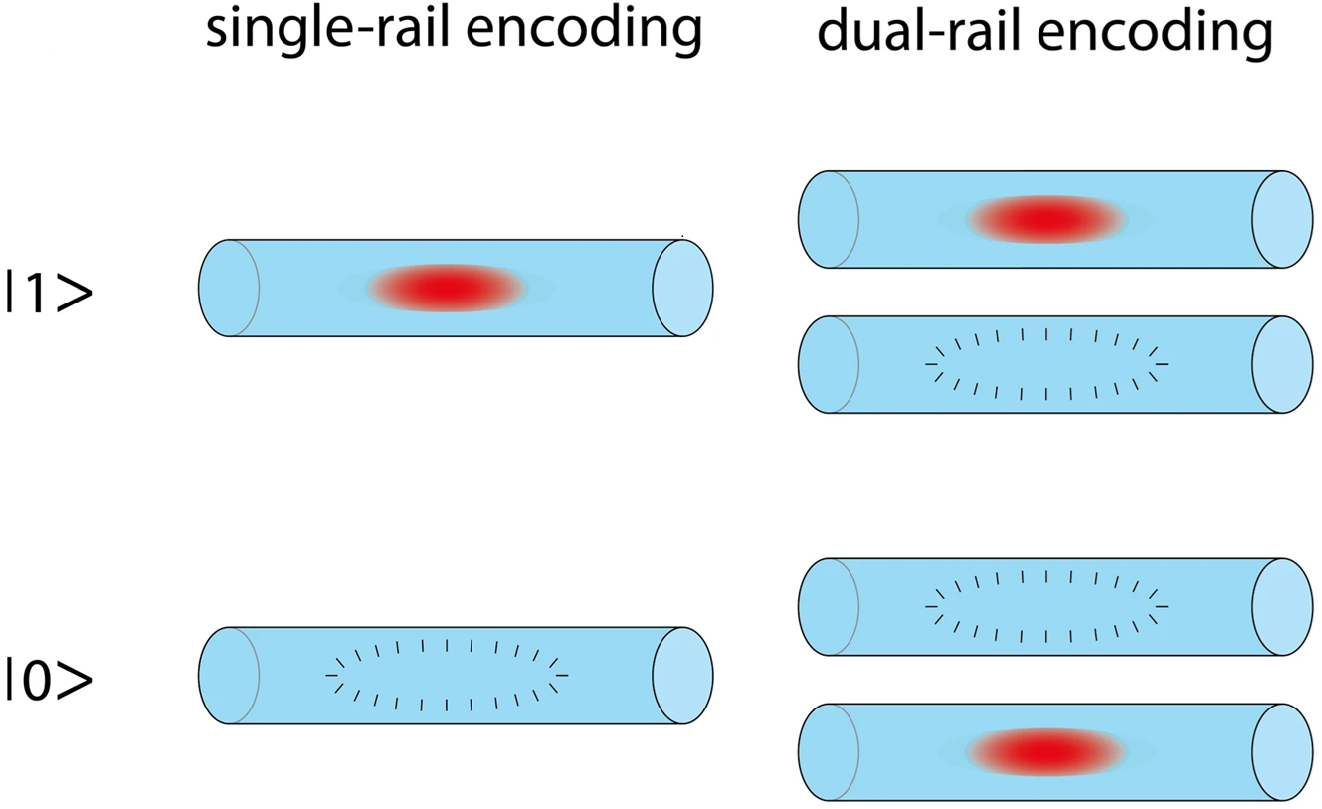
Rail Encoding
Single-Rail Encoding:
Encodes qubit in presence “|1⟩” or absence “|0⟩” of a photon in one mode (e.g. horizontal polarization)
Dual-Rail Encoding:
Encodes qubits using two orthogonal modes: |0⟩ = |1⟩ₖ₁|0⟩ₖ₂, |1⟩ = |0⟩ₖ₁|1⟩ₖ₂
D-Rail Encoding:
Encodes qudits using d orthogonal modes
Wu et al., Sci. Rep. 3, 1394 (2013)
UNIVERSITY OF ILLINOIS URBANA-CHAMPAIGN
GRAINGER ENGINEERING

Slide 10
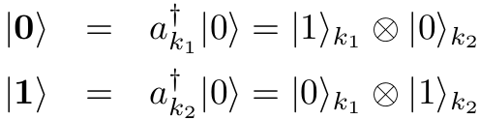
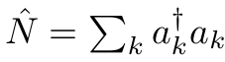
Number State Qubit Encoding
Encode a qubit as a single photon excitation of two orthonormal field modes:
Decode by making a photon number resolving measurement of each mode, which would distinguish between |n⟩ₖ and |n ± 1⟩ₖ states.
Arbitrary qubit state is a single excitation eigenstate of total photon number
UNIVERSITY OF ILLINOIS URBANA-CHAMPAIGN
GRAINGER ENGINEERING

Slide 11
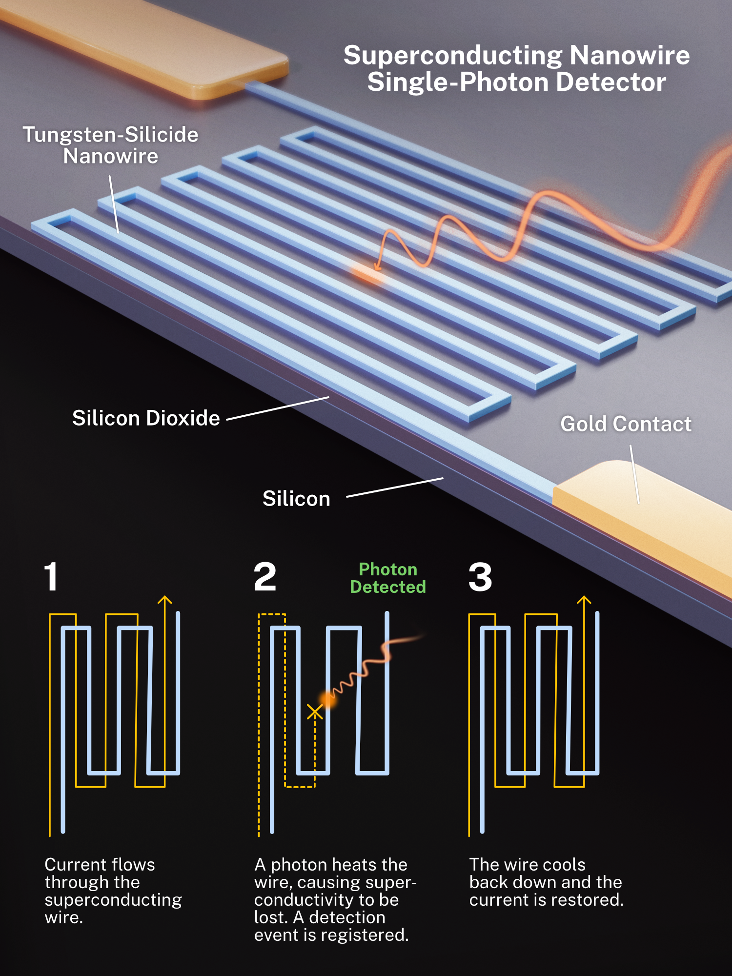
Manipulating and Measuring Photonic Qubits (Reading)
Single-photon detectors
Single-Photon Avalanche Diodes: Avalanche breakdown in a reverse‑biased semiconductor junction
Cheap
Compact
High dark count
SNSPDs: Photon‑induced hotspot in a current‑biased superconducting nanowire
Low noise
High efficiency
Cryogenic requirements
nist.gov/image/superconducting-nanowire-single-photon-detector
UNIVERSITY OF ILLINOIS URBANA-CHAMPAIGN
GRAINGER ENGINEERING

Slide 12
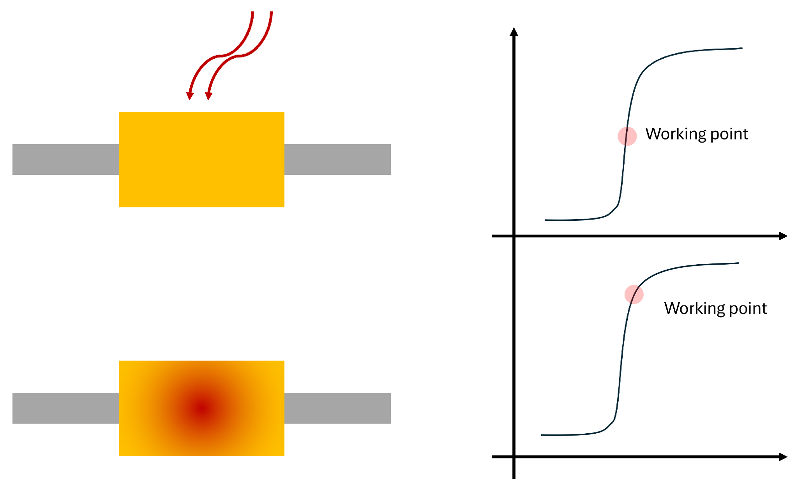
Manipulating and Measuring Photonic Qubits (Reading)
Photon-number resolving detectors
Visible Light Photon Counter: Photons create electron–hole pairs that trigger an avalanche whose amplitude is proportional to the number of incident photons.
High efficiency in the visible band
Cryogenic requirements
Transition Edge Sensors: Calorimetric detection at the superconducting transition edge
High efficiency
Low dark counts
Slow recovery
Cryogenic requirements (sub 100 mK)
De Lucia et al., Instrum. 8, 47 (2024).
nist.gov/image/superconducting-nanowire-single-photon-detector
UNIVERSITY OF ILLINOIS URBANA-CHAMPAIGN
GRAINGER ENGINEERING

Slide 13
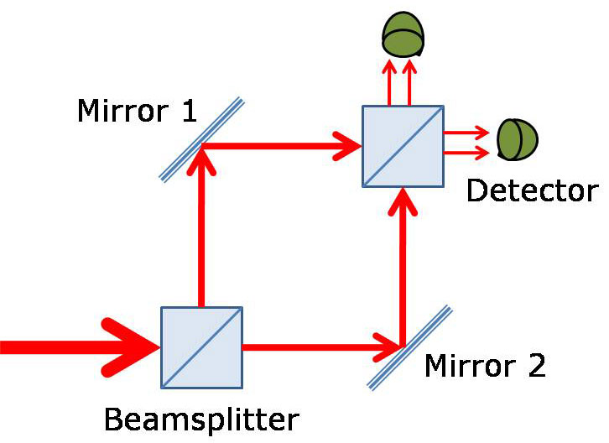
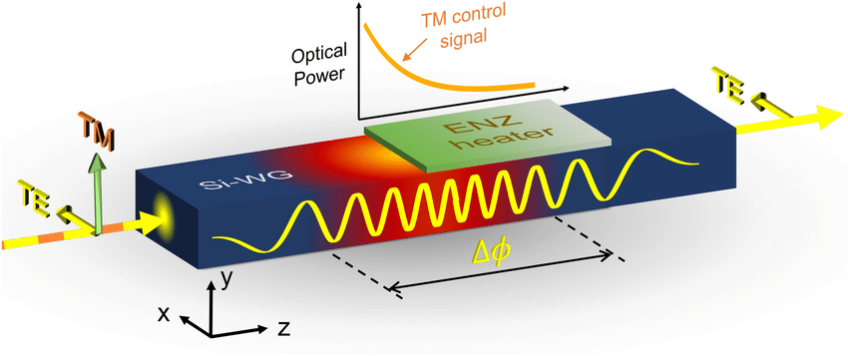
Manipulating and Measuring Photonic Qubits (Writing)
Mach–Zehnder interferometer:
Input into a 50:50 beat splitter, two optical arms (each able to host phase shifters) and outputted into a 50:50 combiner
Each arm acquires a phase ϕ(1)​, ϕ(2)
MZI converts a phase modulation (Δϕ) into an intensity change
Phase shifter performance (speed, loss, noise) directly maps to switch quality
Thermo‑Optic Phase Shifters:
Heat-induced refractive‑index change in one arm of a Mach–Zehnder interferometer
Very low insertion loss, simple drive electronics
Thermal crosstalk in dense circuits, limited modulation bandwidth
Huaqing, et al. have produced a record lowest measured insertion loss of 0.14 dB using a residual‑heat‑absorption method
physics.stackexchange.com/questions/274379/outcome-of-mach-zehnder-interferometer-experiment
Parra et al., Sci. Rep. 11, 9474 (2021).
UNIVERSITY OF ILLINOIS URBANA-CHAMPAIGN
GRAINGER ENGINEERING

Slide 14
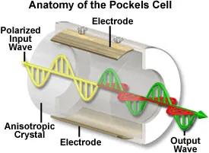
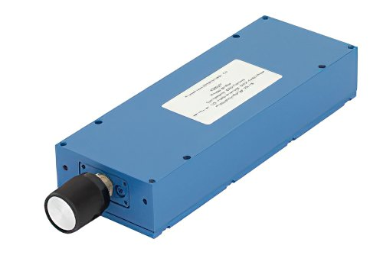
Manipulating and Measuring Photonic Qubits (Writing)
Electro‑Optic Phase Shifters:
Electric‑field–induced refractive‑index change
very high modulation bandwidth, suitable for high‑rate switching in quantum circuits
Higher insertion loss than thermo‑optic, needs high‑precision voltage control
Yaowen, et al. have reported fabricating a thin-film lithium niobate chip with an on-chip insertion loss of 0.45 dB with a frequency shift ratio of over 99%
https://evidentscientific.com/en/microscope-resource/tutorials/pockelscell
Electro‑Mechanical Phase Shifters:
Physical displacement of waveguide or resonator elements via electrostatic actuation
Ultra‑low “open”‑state loss, excellent extinction ratios
Mechanical fatigue, slower than pure electro‑optic devices
Edinger et al. have demonstrated a MEMS silicon photonic chip with a half‑wave voltage–length of 0.0184 V·mm
https://www.pasternack.com/adjustable-phase-shifter-18-ghz-sma-60-deg-per-ghz-pe8247-p.aspx
UNIVERSITY OF ILLINOIS URBANA-CHAMPAIGN
GRAINGER ENGINEERING

Slide 15
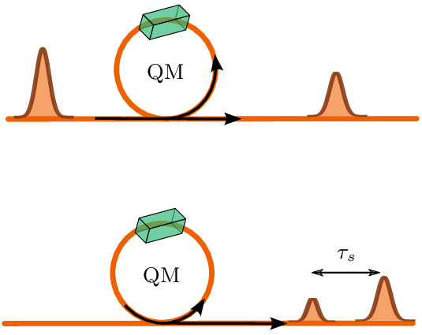
Manipulating and Measuring Photonic Qubits (Storing)
Delay Lines:
Fiber loops act as basic memory by trapping photons in circulating paths
Useful for short-term synchronization or buffering between components
Limited by propagation loss, dispersion, and absence of active control
Quantum Memories:
Store quantum information in a different physical medium (e.g., atomic ensembles)
Often based on Raman protocols
Require high optical depth, mode matching, and low noise to preserve fidelity
Tiranov et al., arXiv:1510.02665 (2015)
UNIVERSITY OF ILLINOIS URBANA-CHAMPAIGN
GRAINGER ENGINEERING

Slide 16
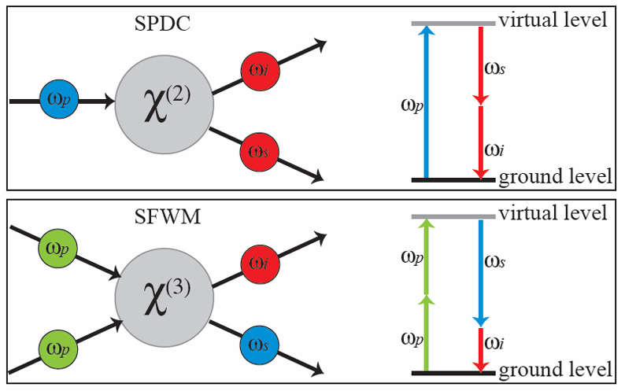
Single Photon Sources
Spontaneous Parametric Down-Conversion (SPDC):
Nonlinear process in χ(2) crystals (e.g., BBO, KDP) where a pump photon splits into two lower-energy photons (signal + idler).
Probabilistic — you get 0, 1, or 2+ photon pairs
Spontaneous Four-Wave Mixing (SFWM):
Occurs in χ(3) nonlinear media like optical fibers or silicon waveguides.
Better suited for integrated photonic platforms, such as on-chip photonic circuits.
Moreno, Ph.D. Diss., Univ. of Delaware (2012)
UNIVERSITY OF ILLINOIS URBANA-CHAMPAIGN
GRAINGER ENGINEERING

Slide 17
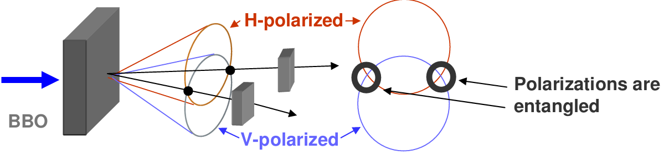
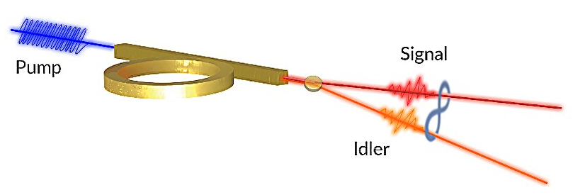
Entanglement Generation
Single Barium Borate (BBO) Crystal:
BBO crystal under type-II phase matching is used to generate non-collinearly propagating photon pairs that are polarization entangled
Kim, Ph.D. Thesis, 2008
Silicon Waveguides:
Two pump photons are annihilated to produce a correlated signal-idler photon pair to generate entangled photons in integrated and fiber-based quantum photonics
Rahmouni et al., Light Sci. Appl. 13, 110 (2024)
UNIVERSITY OF ILLINOIS URBANA-CHAMPAIGN
GRAINGER ENGINEERING

Slide 18
Continuous Variable
Mainly being developed by Xanadu
UNIVERSITY OF ILLINOIS URBANA-CHAMPAIGN
GRAINGER ENGINEERING

Slide 19
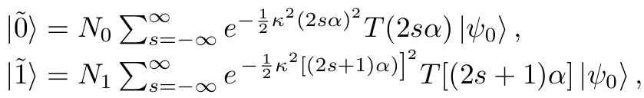
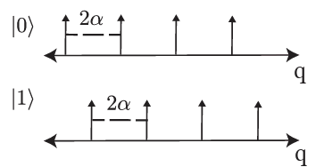
Continuous Variable Qubit Encoding
First Continuous Variable Qubit encoding scheme was proposed in 2001 by Gottesman et al. known as GKP encoding.
Utilizing the fact that each optical mode field is equivalent to a quantised harmonic oscillator
We can define the continuous spectrum qubits as
Ideally this looks like infinite squeezed states with uniform separation
The GKP encoding is of great interest because it is an example of a shift-resistant code, error shifts caused by Pauli Z and X operators
UNIVERSITY OF ILLINOIS URBANA-CHAMPAIGN
GRAINGER ENGINEERING

Slide 20
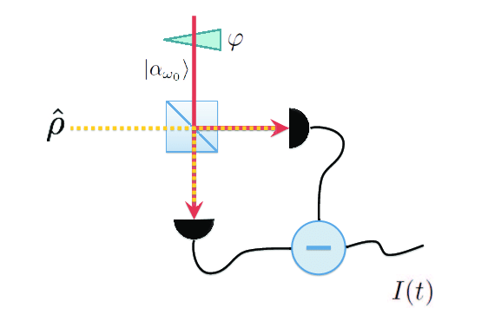
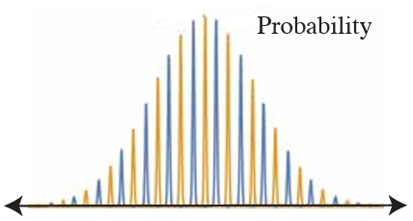
Continuous Variable Qubit Encoding
Measurement:
This is done using Homodyne detection
The qubit is interfered with a strong harmonic oscillator
The output is measured by a photodiode to measure the amplitude of each mode
Romero, et al., arXiv:1703.04548 (2017).
UNIVERSITY OF ILLINOIS URBANA-CHAMPAIGN
GRAINGER ENGINEERING

Slide 21
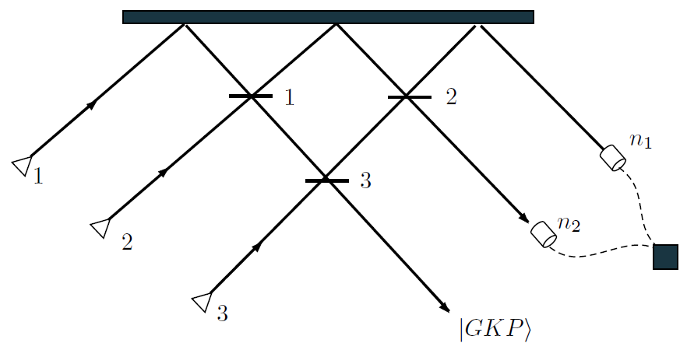
Continuous Variable Gates: Gaussian Boson Sampling
Generation:
Single mode gaussian (squeezed vacuum) states pass through a linear optical network as inputs
Output is measured by photon-number resolving detectors
Used to generate cluster states for Continuous Variable Computing using GKP states
Romero, et al., arXiv:1703.04548 (2017).
UNIVERSITY OF ILLINOIS URBANA-CHAMPAIGN
GRAINGER ENGINEERING

Slide 22
Gates
UNIVERSITY OF ILLINOIS URBANA-CHAMPAIGN
GRAINGER ENGINEERING

Slide 23
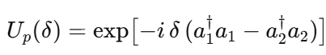
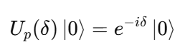
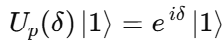
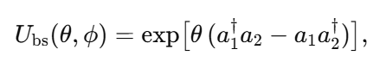
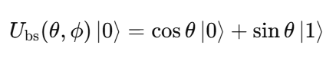
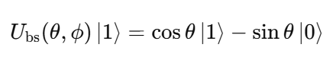
Gates: Unitary Transformations
Phase Gates perform a rotation on the qubit
Photonic qubits are dual rail encoded
|0⟩ = |1⟩ₖ₁|0⟩ₖ₂ |1⟩ = |0⟩ₖ₁|1⟩ₖ₂
We can apply 2 Unitary operations to the qubit
How To Implement Unitary X, Z and H gates?
Beam Splitters mix the two rails
X = U_{bs}(π)
Z = U_{p}(π)
H = U_{p}(π/4)
UNIVERSITY OF ILLINOIS URBANA-CHAMPAIGN
GRAINGER ENGINEERING

Slide 24
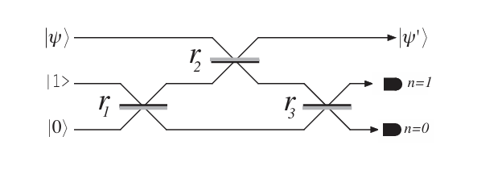
Two qubit gates: Nonlinear Sign Shift (NS) Gate
It is possible to implement two qubit gates using only single qubit gates, photon sources, and detectors that can distinguish between 0, 1 and 2 photons
This is done by using the NS gate(which is a single qubit gate)
For an input mode:
|Ψ> = α₀|0> + α₁|1> + α₂|2> -> α₀|0> + α₁|1> - α₂|2>
The NS gate flips the two photon component,
This is done using two ancillary qubits, the operation is only successful when the detector shows 1 photon in mode 2 and 0 in mode 3
This only happens 1/4th of the time
Romero, et al., arXiv:1703.04548 (2017).
UNIVERSITY OF ILLINOIS URBANA-CHAMPAIGN
GRAINGER ENGINEERING

Slide 25
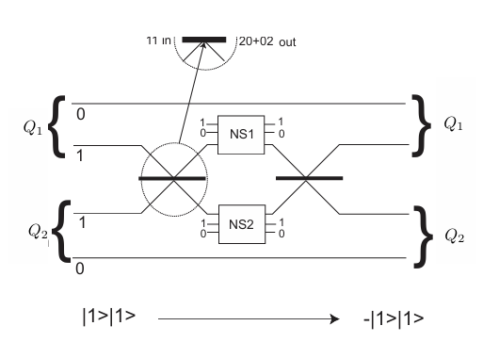
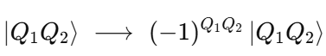
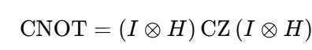
d
Two Qubit gates: CZ and CNOT
CZ gates can be implemented using two NS gates
The first beam splitter creates two photons in a mode when |Q₁, Q₂> = |0,1> and the NS gate flips the sign
The output is
CNOT gates are implemented as
This process works but is very inefficient.
10¹⁴ operations are required to implement a CZ gate that succeeds 95% of the time
Two qubit gates: CNOT and CZ gate
Romero, et al., arXiv:1703.04548 (2017).
UNIVERSITY OF ILLINOIS URBANA-CHAMPAIGN
GRAINGER ENGINEERING

Slide 26
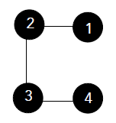
Cluster States
Generation:
Take N qubits, all prepared in the logical |0⟩ state
Represent each qubit as a node in a two dimensional graph
Apply a Hadamard gate to each one
Apply a CZ gate between all qubits connected by an edge
Importance:
Computation is performed by measuring qubits instead of applying gates
Core resource for Measurement-Based Quantum Computation (MBQC)
Measurement results can be adaptively corrected to stay on track
UNIVERSITY OF ILLINOIS URBANA-CHAMPAIGN
GRAINGER ENGINEERING

Slide 27
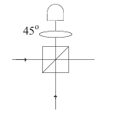
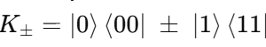
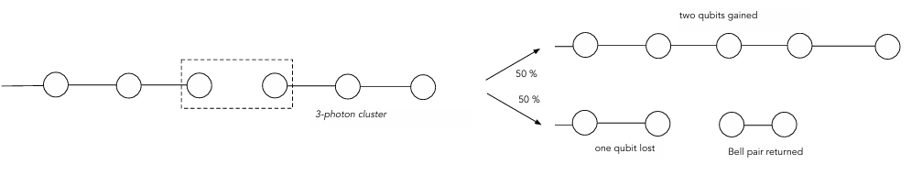
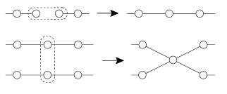
Cluster Gates: Fusion Gate
Fusion gates on cluster states are more efficient than NS gates
Fusion gates (Type 1)
These gates apply Kraus operators on two qubits
This process destroys one qubit and has a success probability p= ½
Cluster properties are inherited between two source qubits
Type 1 fusion gates can be used to add qubits to the cluster
Type 1 Fusion Gate
Brown et al, arXiv quant-ph 0405157(2005)
Romero, et al., arXiv:1703.04548 (2017).
UNIVERSITY OF ILLINOIS URBANA-CHAMPAIGN
GRAINGER ENGINEERING

Slide 28
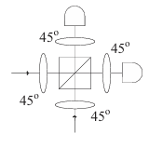
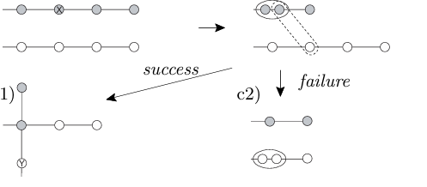
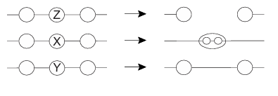
Fusion Gates cont
Fusion Gates(Type 2)
Type 2 Fusion gates apply the operators
L± = <00| ± <11|
Fusion gates are used to create two dimensional clusters
First, σ_{x} measurement on clusters are used to make redundant qubits
Then Type 2 fusion either joins the cluster or creates more redundant qubits which can be used to try again
Type 2 Fusion Gate
Brown et al, arXiv quant-ph 0405157(2005)
UNIVERSITY OF ILLINOIS URBANA-CHAMPAIGN
GRAINGER ENGINEERING

Slide 29
Decoherence & Losses
UNIVERSITY OF ILLINOIS URBANA-CHAMPAIGN
GRAINGER ENGINEERING

Slide 30
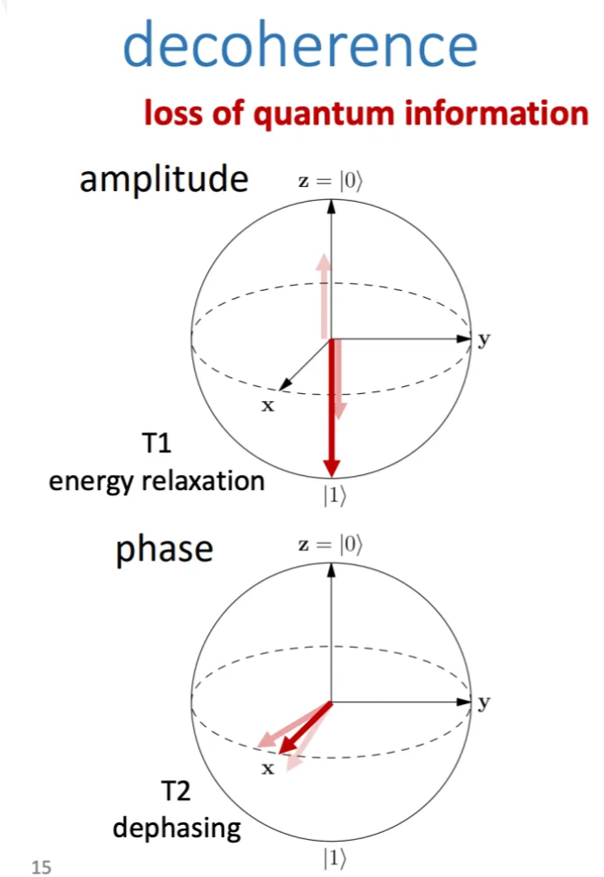
Decoherence Mechanisms
Resilient against many typical decoherence mechanisms
Little interaction with the environment (immune to thermal noise, stray fields, etc.)
No “excited state” needed, so no relaxation
General Mechanisms
Mechanical and thermal fluctuations
Variations in path length
Changes in refractive index
Major source of error - Photon Loss
Many factors
https://jonathan-hui.medium.com/qc-quantum-programming-implementation-issues-51e3a146645e
UNIVERSITY OF ILLINOIS URBANA-CHAMPAIGN
GRAINGER ENGINEERING

Slide 31
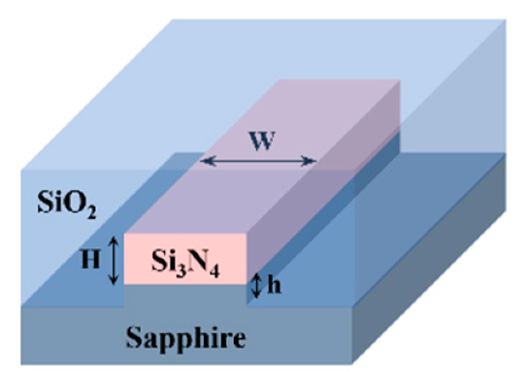
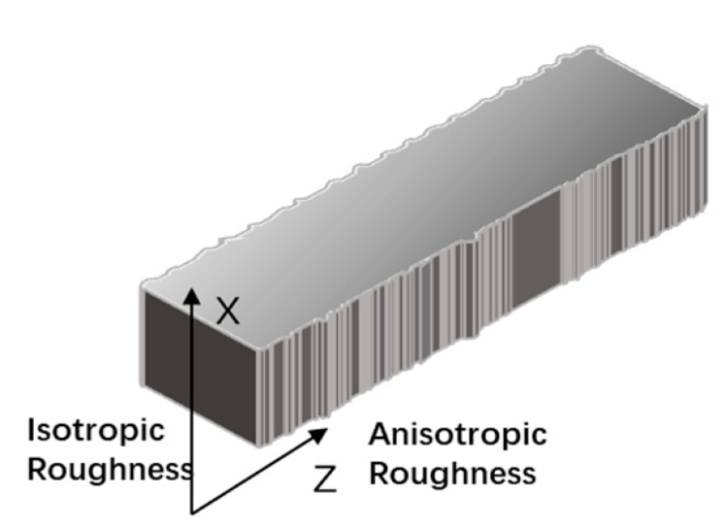
Optical Transport Losses
Losses occur within a photonic chip
Losses during propagation in waveguides
Volume scattering, surface scattering from imperfections
Absorption losses
Losses in optical fibers
Absorption losses
Scattering
Chip to fiber coupling losses
Scattering at interface
Imperfections
Alignment
https://www.mdpi.com/1996-1944/17/16/4148
https://www.mdpi.com/2079-6412/10/3/236
UNIVERSITY OF ILLINOIS URBANA-CHAMPAIGN
GRAINGER ENGINEERING

Slide 32
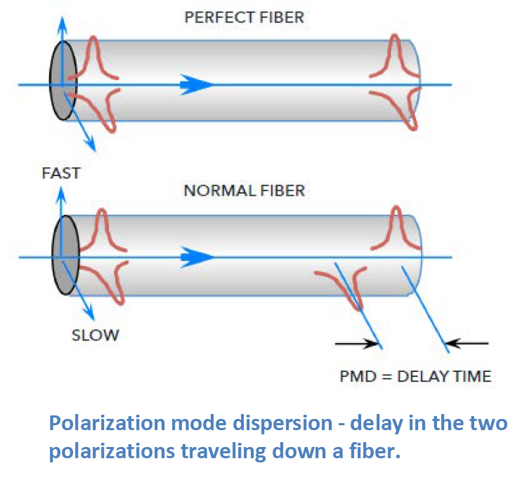
Decoherence Mechanisms (Polarization)
Other Losses Can Occur in Fibers
Polarization Encoding
Polarization states can usually be maintained over significant distances
Polarization mode dispersion (PMD) occurs in optical fibers
Difference polarization modes travel at different speeds due to fiber imperfections
Causes entanglement degradation
https://www.ofsoptics.com/category/technical-article/
UNIVERSITY OF ILLINOIS URBANA-CHAMPAIGN
GRAINGER ENGINEERING

Slide 33
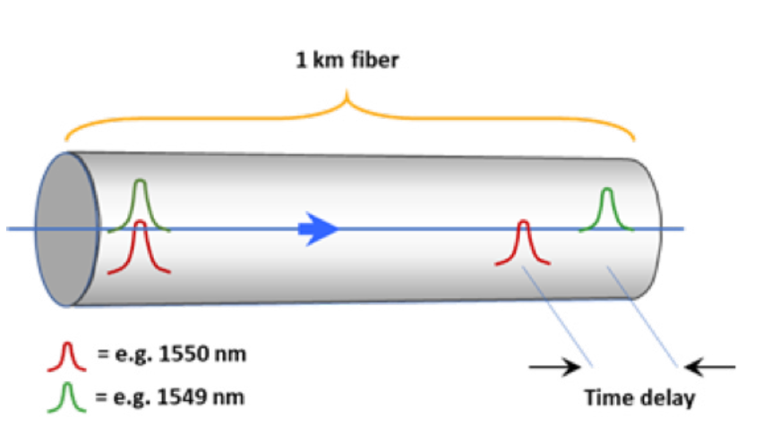
Decoherence Mechanisms (Time-Bin)
Time-Bin Encoding
Chromatic dispersion causes the smearing of Gaussian pulses
Causes loss of distinguishability between “early” and “late” time-bins
https://www.ofsoptics.com/category/technical-article/
UNIVERSITY OF ILLINOIS URBANA-CHAMPAIGN
GRAINGER ENGINEERING

Slide 34
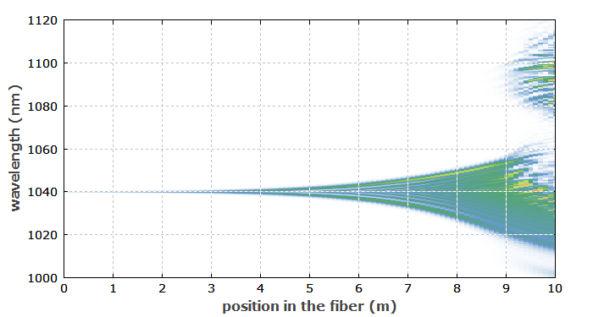
Raman Scattering
Raman Scattering occurs when phonons in the medium inelastically scatter photons, resulting in higher/lower wavelengths
Thermal Noise
Thermal phonons scatter photons
Classical and Quantum Channel Crosstalk
Classical photons cause stimulated Raman scattering
Four wave mixing and other non-linear effects
https://www.rp-photonics.com/raman_scattering.html#:~:text=In%20the%20Raman%20scattering%20process,quantum%20of%20the%20lattice%20vibrations).
UNIVERSITY OF ILLINOIS URBANA-CHAMPAIGN
GRAINGER ENGINEERING

Slide 35
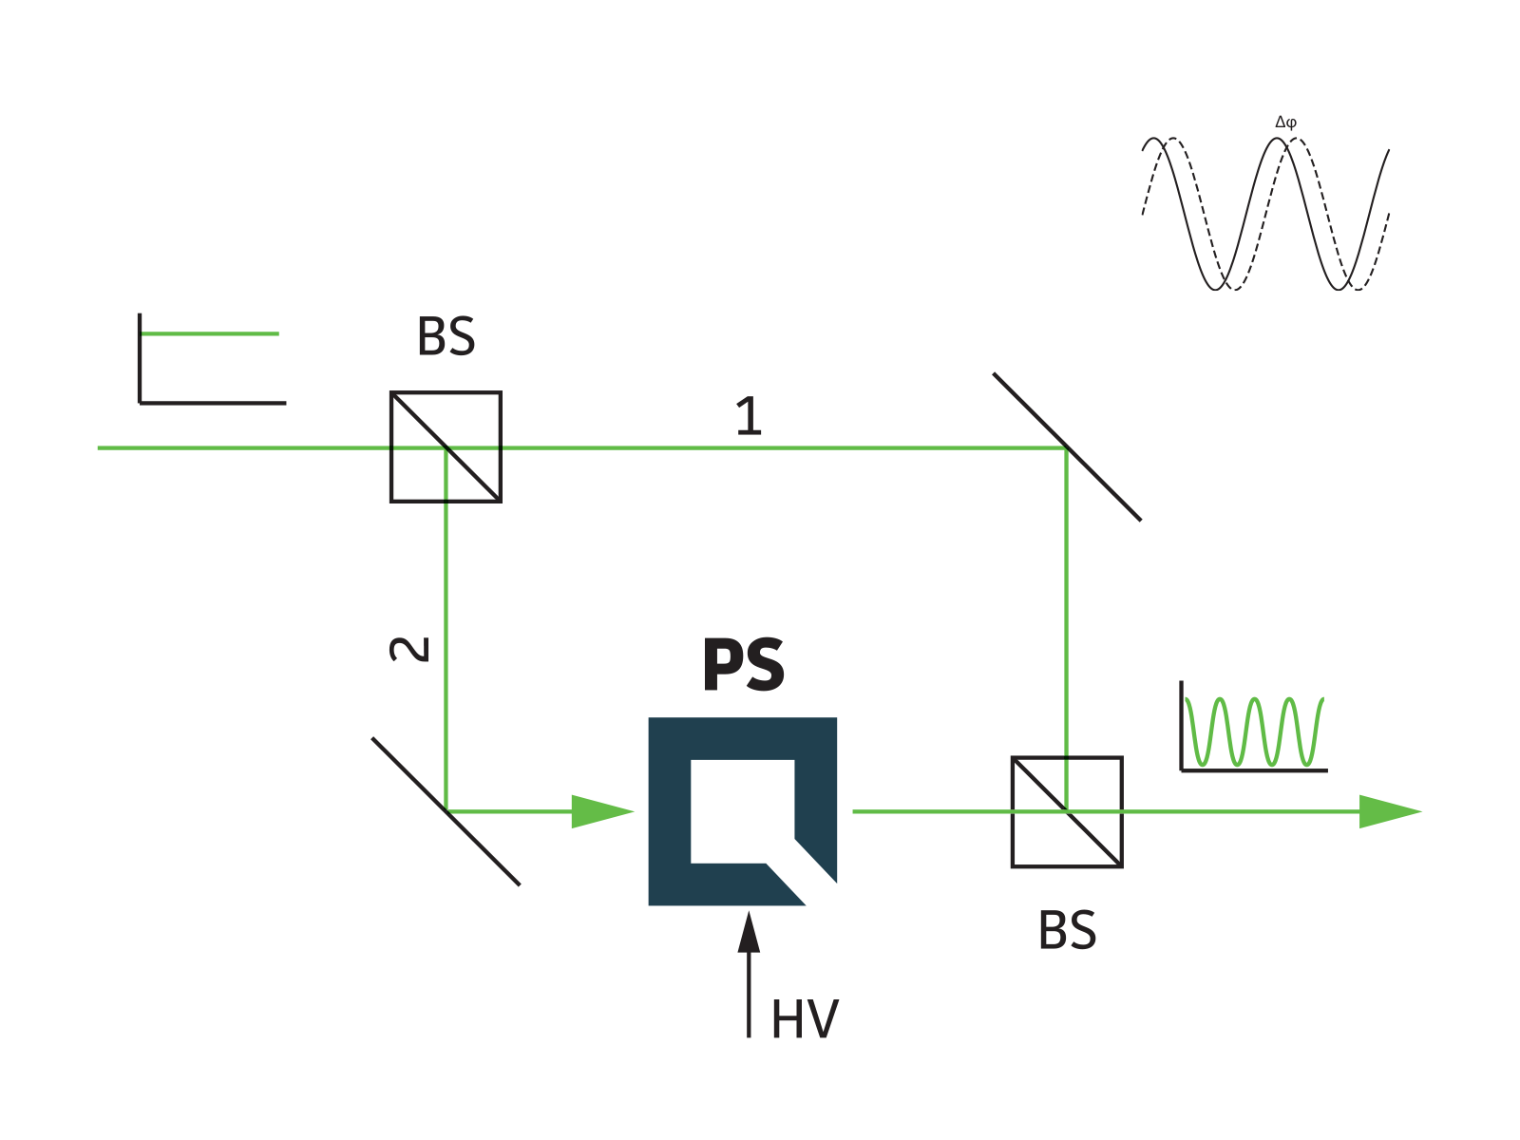
Gate Losses
Beam Splitters
Absorption
Not ideally 50/50
Phase shifters
Insertion Loss
Electrical noise from voltage source
Probabilistic Gates
Requires post-selection which mean discarding many attempts
https://www.qubig.com/products/electro-optic-modulators_eom/phase-shifters_ps
UNIVERSITY OF ILLINOIS URBANA-CHAMPAIGN
GRAINGER ENGINEERING

Slide 36
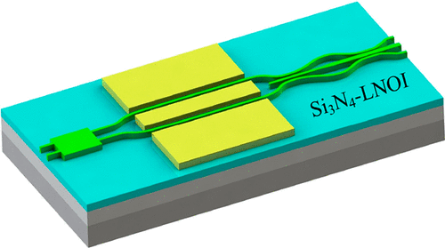
Phase Shifters
Electro-Optical vs. Electro-Mechanical
Insertion loss: loss from passing through
Switching speed: speed from on to off
Barium Titanate
0.1 dB insertion loss
2 ns switching speeds
Lithium Niobate
4.3 dB insertion loss
46 fs switching speeds
Silicon MEMS
0.5 dB insertion loss
< 1 μs switching speed
UNIVERSITY OF ILLINOIS URBANA-CHAMPAIGN
GRAINGER ENGINEERING

Slide 37

Detector Losses and Errors
Shot Noise
Intrinsic uncertainty in the photon count number
Limits measurement precision
Timing Jitter
Uncertainty in the arrival time of the photon
Incomplete Absorption
Misses some fraction of photons
Dark Counts
Photon counts when no photon was present (false positive)
https://www.researchgate.net/figure/Single-photon-timing-jitter-measurement-results-for-IPD-with-08-m-InGaAsP-layer_fig1_268004438
UNIVERSITY OF ILLINOIS URBANA-CHAMPAIGN
GRAINGER ENGINEERING

Slide 38
Category | Device | Efficiency/Loss Rate | Source
Photon Sources | Silicon Waveguides | ~12% Heralding Efficiency | Link (2023)
 | Spontaneous Parametric Down Conversion | >90% Heralding Efficiency | Link (2016)
Photonics Hardware | Waveguides | 0.5 ± 0.3 dB/m Propagation Loss | PsiQuantum (2024)
 | Beam Splitters | 0.5 ± 0.2 mdB Insertion Loss | PsiQuantum (2024)
 | Phase Shifters (Electro-Optical) | 0.1 dB Insertion Loss | PsiQuantum (2024)
 | Phase Shifters (Electro-Mechanical) | 3.7 dB Insertion Loss | Link (2016)
 | Optical Fibers | 0.2 dB/km Propagation Loss | Link
 | Fiber-Chip Coupling | 52 ± 12 mdB Insertion Loss | PsiQuantum (2024)
Gates | Fusion Gates | 99.5% type 1, 99.2% type 2 | PsiQuantum (2024)
Photon Detectors | Superconducting Single-Photon Detector | 88.9% ± 3.5% Efficiency | PsiQuantum (2024)
 | Transition Edge Sensors | 95% ± 2% Efficiency | Link (2008)
 | Avalanche Photodiodes | 20% - 40% Efficiency | Link (2023)
Quantum Repeaters | Quantum Memory | 87% ± 2% Efficiency (short-term) | Link (2016)

Slide 39


Mitigating Losses
Decoherence Free Subspaces
Bell States |01> ± |10> are a DFS against collective decoherence
Protection from Losses
Dual-Rail encoding and post-selection protects against photon loss
Various error correction schemes
Quantum repeaters
Entanglement swapping
Quantum memory
https://research.physics.illinois.edu/QI/Photonics/papers/My%20Collection.Data/PDF/Experimental%20verification%20of%20decoherence-free%20subspaces.pdf
https://projectqsydney.com/the-who-what-where-when-and-why-of-a-quantum-internet/
UNIVERSITY OF ILLINOIS URBANA-CHAMPAIGN
GRAINGER ENGINEERING

Slide 40

Error Correction (Discrete Variable)
Topological Error Correction
Requires cluster states in ≥ 3 dimensions
Protects against single qubit errors
Simultaneous errors across multiple qubits can also be reduced
Fusion-based quantum computation
Use of fusion gates
Fusion networks: configuration of fusion measurements
Fault Tolerance
UNIVERSITY OF ILLINOIS URBANA-CHAMPAIGN
GRAINGER ENGINEERING

Slide 41

Error Correction (Continuous Variable)
Cat Codes
Superpositions of coherent states
Many variants which try to protect against losses like single photon losses and dephasing errors
GKP Codes
A qubit is encoded as a location in phase space
Protects against small shifts in the phase space
Cannot protect against large shifts
https://medium.com/xanaduai/from-a-state-of-light-to-state-of-the-art-the-photonic-path-to-millions-of-qubits-c0e08ca1cb21
UNIVERSITY OF ILLINOIS URBANA-CHAMPAIGN
GRAINGER ENGINEERING

Slide 42

Scalability Advantages and Disadvantages
Advantages
Limited need for cryogenic systems (other than for high efficiency detectors)
Easy transport of photons (optical fibers)
High modularity
Large scale manufacturing already exists for devices (can use existing infrastructure)
Robust telecom networks already exist
Relatively less decoherence needed
Disadvantages
Loss rates can be high
Single photon sources and detectors are difficult
Difficult to generate GKP states
https://www.businesswire.com/news/home/20230303005312/en/PsiQuantum-Opens-UK-Based-Research-Facility-to-Develop-Next-Generation-High-Power-Cryogenic-Systems-for-Large-Scale-Quantum-Computing
UNIVERSITY OF ILLINOIS URBANA-CHAMPAIGN
GRAINGER ENGINEERING

Slide 43
Improvements in Loss and Scalability
Improvements have been made to mitigate factors like loss
Improved detectors with superconducting single-photon detectors
Better optical switches
Ideas for improving scalability of technology
Using standard commercially available photonic chips
Higher temperature high efficiency single photon detectors
UNIVERSITY OF ILLINOIS URBANA-CHAMPAIGN
GRAINGER ENGINEERING

Slide 44
Current Progress
UNIVERSITY OF ILLINOIS URBANA-CHAMPAIGN
GRAINGER ENGINEERING

Slide 45

Photonic QC Groups
Jian-wei Pan Group (University of Science and Technology of China)
Demonstrated Quantum Advantage -> Boson Sampling
Solving Classicially requires calculating the permanent of NxN matrix
runtime
Quicker to do quantum mechanically
Achieved sampling rate faster by 10¹⁴ s
*Not a practical problem
*The “JiuZhang” quantum computer can’t solve other tasks
Jian-Wei Pan, et al. arXiv:2012.01625 (2020).
García-Patrón R., et al.arXiv:1712.10037v3 (2019)
UNIVERSITY OF ILLINOIS URBANA-CHAMPAIGN
GRAINGER ENGINEERING

Slide 46


Current Status
– Developing the continuous variable approach
Development timeline:
2025: Created “Aurora”
Photonic quantum computer with 12 qubits
Created out of 4 modular and independent server racks
Each server rack is networked together
Future plans:
Avoid scaling to address performance issues
Address the optical loss in their systems
For better error correction and fault tolerance
Aghaee Rad, H., et al. https://doi.org/10.1038/s41586-024-08406-9 (2025)
UNIVERSITY OF ILLINOIS URBANA-CHAMPAIGN
GRAINGER ENGINEERING

Slide 47

Current Status
Architecture:
Gaussian Boson Sampling
GKP States
Entangle outputs to form cluster state
Measure nodes of cluster state
Optical loss along paths (95% on P2 and P3)
56% along P1
Fault tolerance requires: ~1% loss currently
Aghaee Rad, H., et al. https://doi.org/10.1038/s41586-024-08406-9 (2025)
UNIVERSITY OF ILLINOIS URBANA-CHAMPAIGN
GRAINGER ENGINEERING

Slide 48
Current Status
Advantages compared to discrete variable
Logic gates and error correction can be done with linear optical operations that are:
Deterministic
Can happen at room temperature
Have “modest component depths”
Aghaee Rad, H., et al. https://doi.org/10.1038/s41586-024-08406-9 (2025)
UNIVERSITY OF ILLINOIS URBANA-CHAMPAIGN
GRAINGER ENGINEERING

Slide 49

Current Status
Disadvantages compared to discrete variable
Best results for creating GKP states from GBS has success chance equal to 2.22 × 10e−10¹
Fidelity =0.996
Cryogenics still required for qubit encoding
How large would a current, loss-tolerant 100 logical qubit Quantum computer be?
>10 Million times as big as “Aurora”
(assuming scalability and etc.)
¹Takase, K., et al. https://doi.org/10.1038/s41534-023-00772-y (2023)
Aghaee Rad, H., et al. https://doi.org/10.1038/s41586-024-08406-9 (2025)
UNIVERSITY OF ILLINOIS URBANA-CHAMPAIGN
GRAINGER ENGINEERING

Slide 50



Current Status
– Developing the discrete variable approach
Development timeline:
2016: Founded
2024:
Started project in Chicago to build large scale “quantum and microelectronics park” ($500 million project)
Received $617 million to build a commercial quantum computer in Australia
2025:
Deploy the first million-qubit systems at both sites
2029 (or sooner):
Deliver first commercial quantum computing system
Similar date as Google and others
https://www.psiquantum.com/
UNIVERSITY OF ILLINOIS URBANA-CHAMPAIGN
GRAINGER ENGINEERING

Slide 51


Current Status
Blueprint:
Photonic components fabricated onto regular silicon wafers
Allows for reliable fabrication of chips at high-volumes
https://www.psiquantum.com/blueprint
UNIVERSITY OF ILLINOIS URBANA-CHAMPAIGN
GRAINGER ENGINEERING

Slide 52


Current Status
Blueprint:
Chips must operate at ~4K because of the photon detectors
https://www.psiquantum.com/blueprint
UNIVERSITY OF ILLINOIS URBANA-CHAMPAIGN
GRAINGER ENGINEERING

Slide 53

Current Status
Architecture:
Bartolucci, S., et al. https://doi.org/10.1038/s41467-023-36493-1 (2023).
https://www.psiquantum.com/blueprint
UNIVERSITY OF ILLINOIS URBANA-CHAMPAIGN
GRAINGER ENGINEERING

Slide 54
Current Status
Results:
Have created quantum computation systems that are scalable and modular
Scalability because of optical fibers
Allows for error correction
Multiplexing and error correction coding
Single-qubit fidelity: 99.99%
Two-qubit fidelity: >99%
https://www.psiquantum.com/
UNIVERSITY OF ILLINOIS URBANA-CHAMPAIGN
GRAINGER ENGINEERING

Slide 55
Questions?

